Slide 1
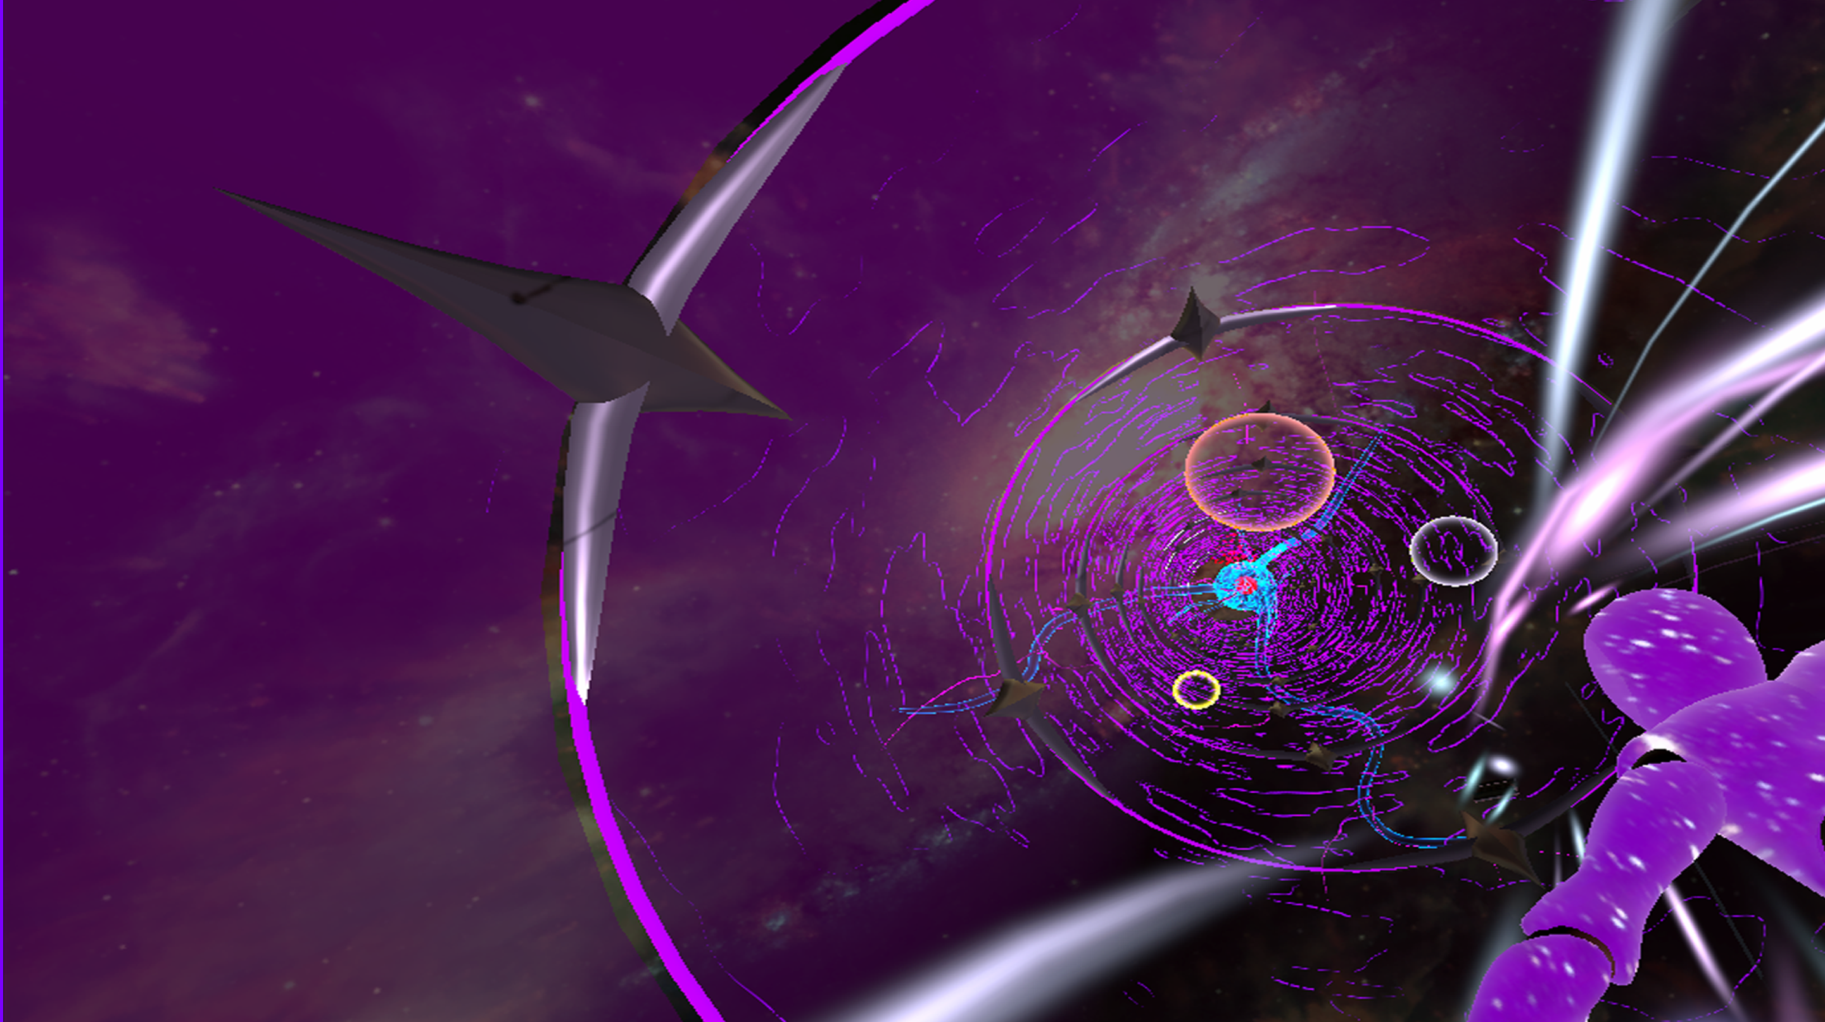
FALLING MEMORIES
A game realised by
Hannes De Wispelaere

Slide 2
PITCH

Slide 3
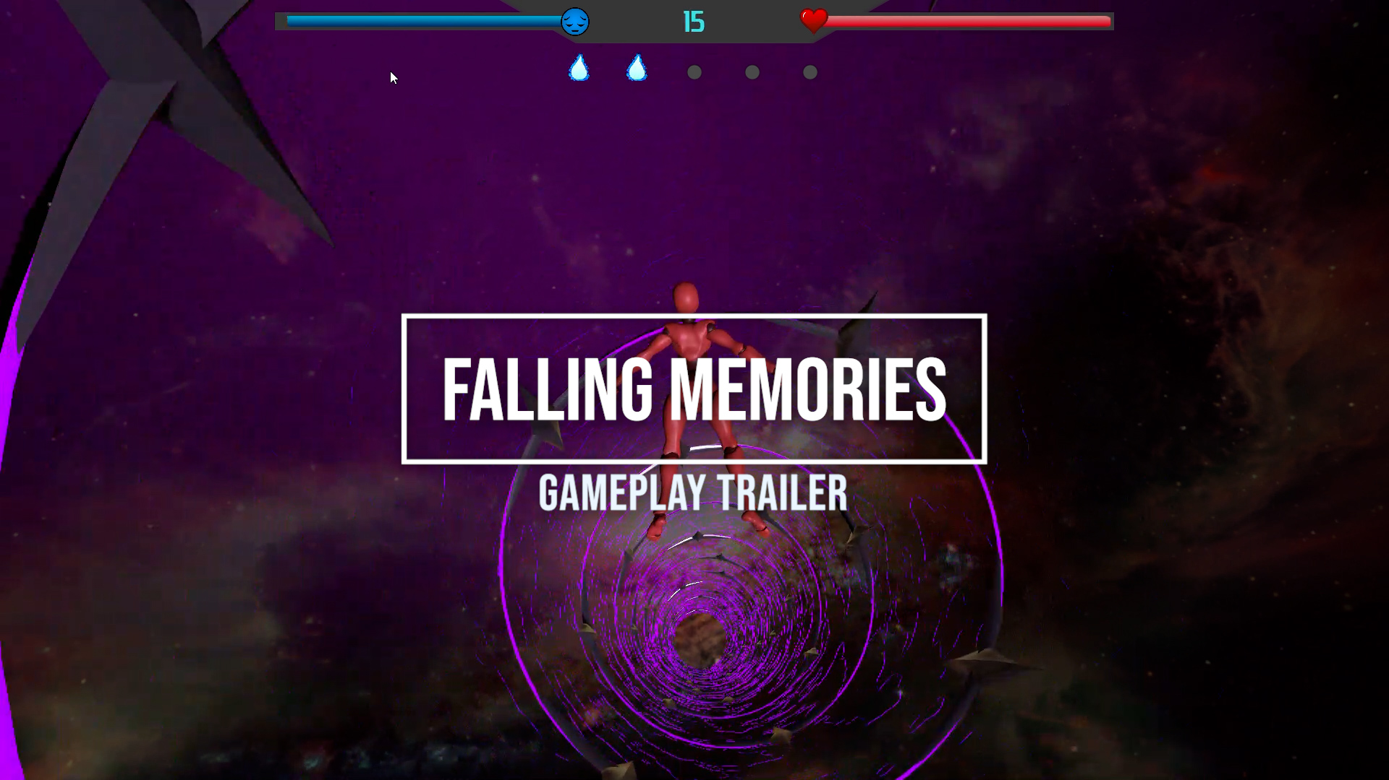
GAMEPLAY TRAILER
Mercury is the closest planet to the Sun and the smallest one in the Solar System—it’s only a bit larger than the Moon. The planet’s name has nothing to do with the liquid metal, since Mercury was named after the Roman messenger god

Slide 4
UNIQUE SELLING POINTS
Fast paced, challenging gameplay with high score leaderboard
Playable in short periods
Psychedelic visual experience

Slide 5

GENRE
ACTION, ARCADE

Slide 6
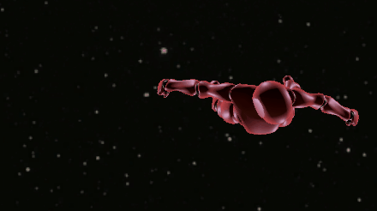
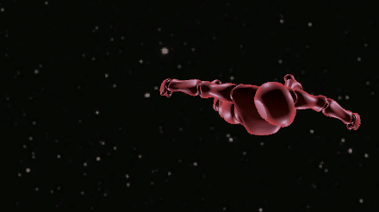
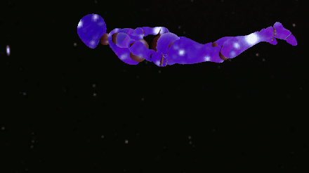
CHARACTER
Evade
Boost
Dive
Older, long-white-haired character in a hospital gown

Slide 7

CONTROLLER
Evade Left
Dive
Move
Evade Right
Boost
Menu Navigation
Camera Orbit

Slide 8
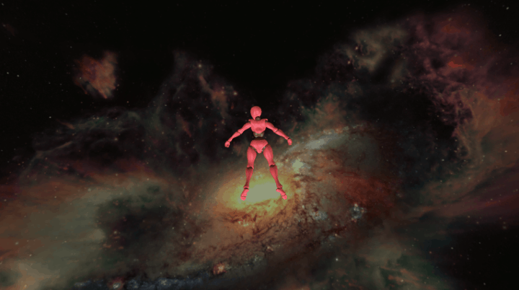
CAMERA
3rd Person
180 horizontal camera orbit
Dive camera
Camera blending
Camera shake events

Slide 9

LEVEL
• Procedural generated endless tunnel
• Variety of sections
• Contained inside the tunnel
• Falling objects to avoid

Slide 10
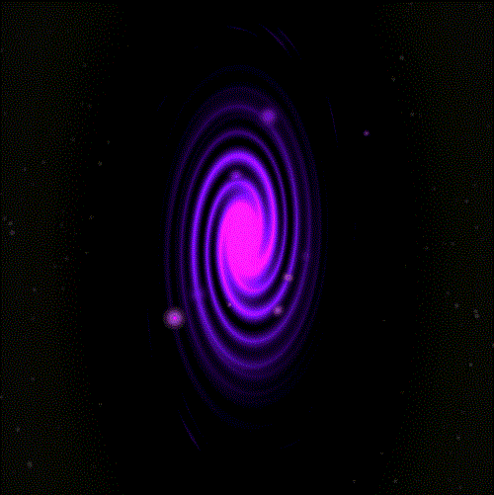
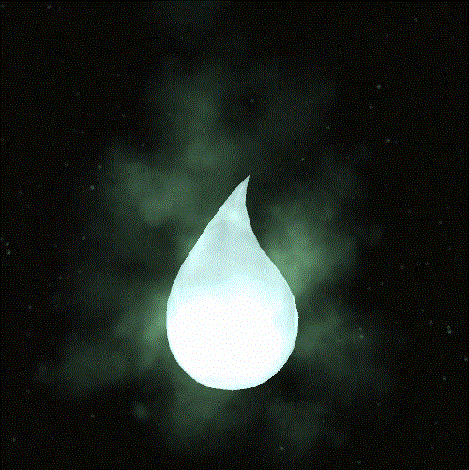
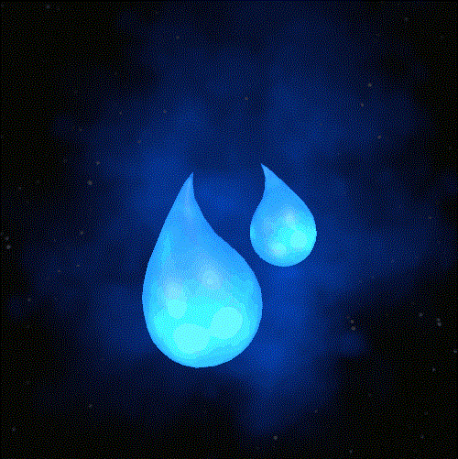
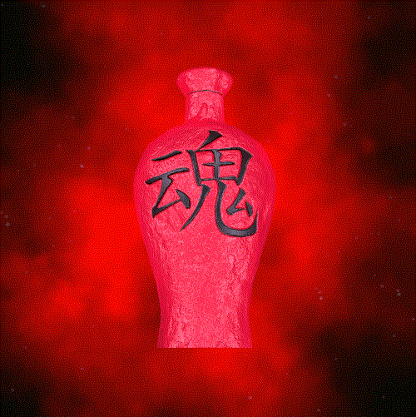
LEVEL OBJECTS
Whisp
Dual whisp
Spirit wine
Escape portal

Slide 11
THE GOAL
SURVIVE
HIGHSCORE

Slide 12
LET’S PLAY

Slide 13
THANKS!
Do you have any questions?

